Slide 1


Introduction
ACCESSDATA® FORENSICS
Encrypting File System
Forensic Analysis
Incident Response
eDiscovery
Information Assurance

Slide 2
Module Objectives
EFS – The Process
  The “FEK”
  Public and Private Keys
  Encrypt and Recovery Agents
EFS – The Problem
  Current – Lost Passwords, Access to files, Who Encrypted it?
EFS – The Solution
  Current – Vulnerability and Advanced Attack (FTK/PRTK)
    Obtaining the DD Private Key
    Obtaining the DR Private Key

Slide 3
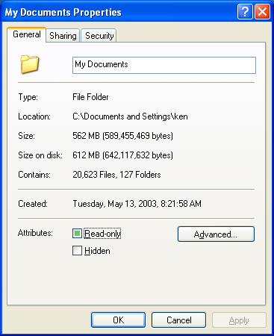
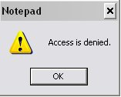
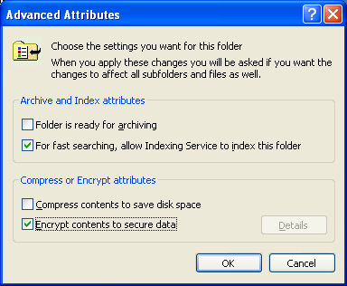
EFS – Overview

Slide 4
EFS – The Activation
return
User Login - Password
MD4 Password – Stored in SAM = “Passkey”
“Passkey” combined with “Protect Info” generates the “Master Key”
Windows generates a user PVT/PUB set
“Master Key” used to encrypt the user PVT Key

Slide 5

EFS – Logon Password → Hash
WINDOWS LOGON
CAT
MD4 / SHA
= A2D3C1AE4FD2EAC213DE45FA2DEC2AE2

Slide 6
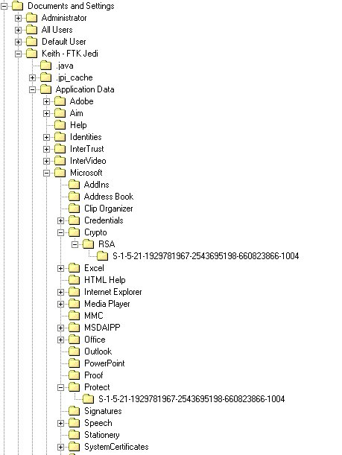


EFS – The Keys
RSA info located in C:\ Documents and Settings \ ~user \ Application Data \ Microsoft \ RSA \ ~SID
Protect info located in C:\ Documents and Settings \ ~user \ Application Data \ Microsoft \ Protect \ ~SID

Slide 7
EFS – The Event
Each encrypt occurrence generates new FEK
  Symmetric key – fast for large volumes of data
FEK encrypted with user’s PUB key
Each encrypted item contains $EFS stream
  Record attribute in NTFS (Logged Utility Stream)
stream contains DDF/DRF fields (OS?)
  Data “Decryption” field (FEK encrypted with user PUB)
  Data “Recovery” field (FEK with recovery agent PUB)
Data encrypted with “File Encryption Key”
$EFS

Slide 8
Symmetric Key Encryption
Plain
Text
Cipher
Text
KEY
KEY
Software
Software
Cipher
Text
Plain
Text
Also referred to as Single Key Encryption, Secret Key Encryption, or One Key Algorithms

Slide 9
Asymmetric Key Encryption
Plain Text
Cipher
Text
Recipient
Public Key
1234
Private Key
5678
Sender
Cipher
Text
Plaintext

Slide 10
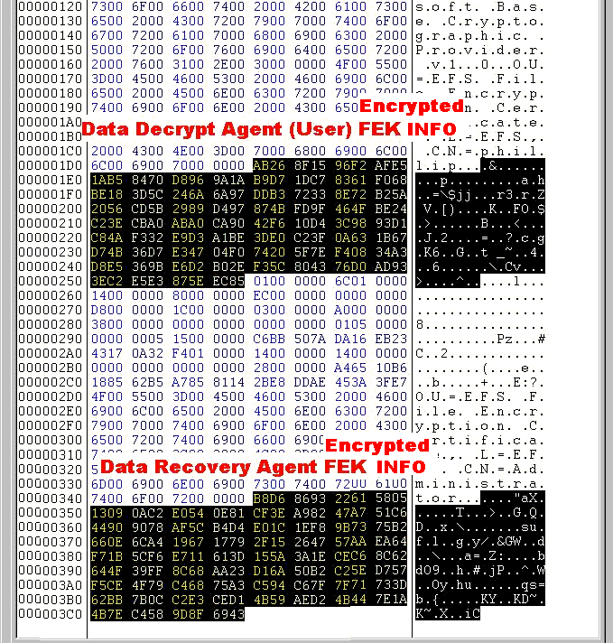
EFS – $EFS
($EFS)
A logged utility stream within the EFS encrypted file
This is what FTK displays as $EFS, a “child” of an encrypted file in the file list pane
Note users that have access to the encrypted file

Slide 11
EFS – The Process
return
User Logon =Keith
Password = House
MD4 “House” = A2D3C1AE4FD2EAC213DE45FA2DEC2AE2
“master key” steps
PVT
PUB
← RSA
Data encrypted with FEK
FEK
DESX / 3DES ← AES-256 ??
Encrypted FEK
stored in $EFS
Encrypted Data

Slide 12
EFS – The Problems
What happens if user forgets login password
How to access EFS Encrypted files from a forensic image – don’t export
Determining who Encrypted the files

Slide 13
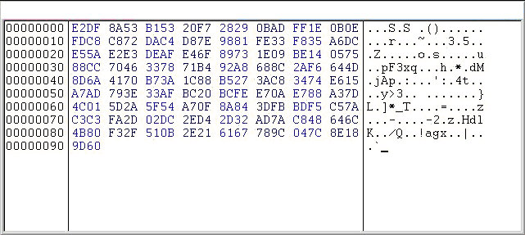
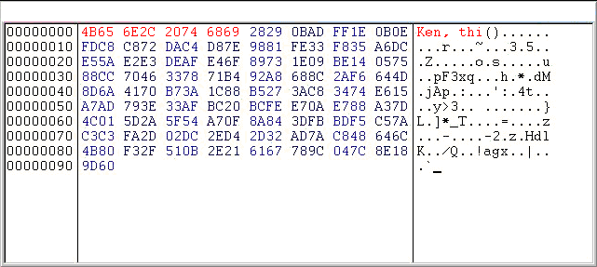
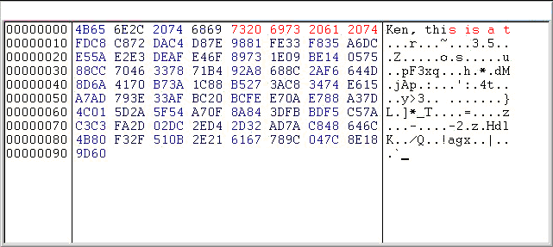
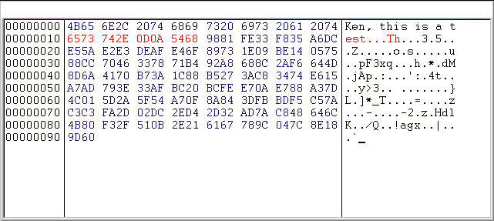
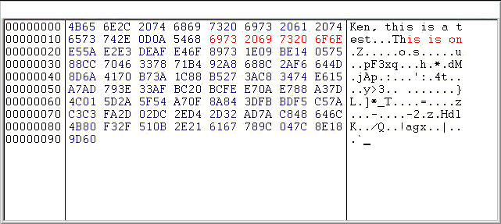
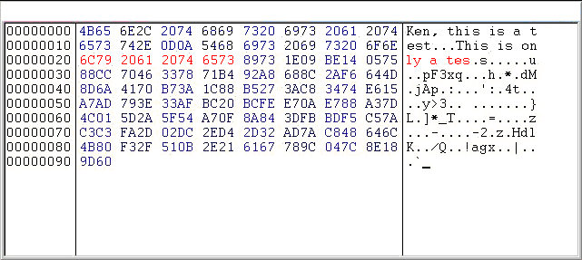
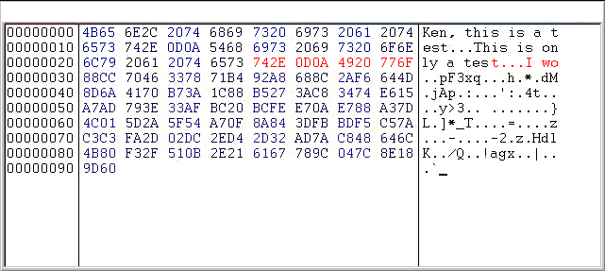
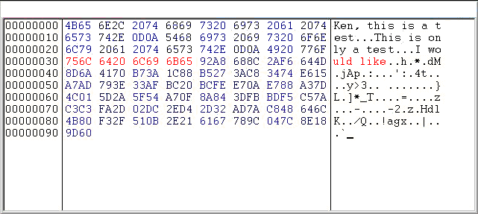
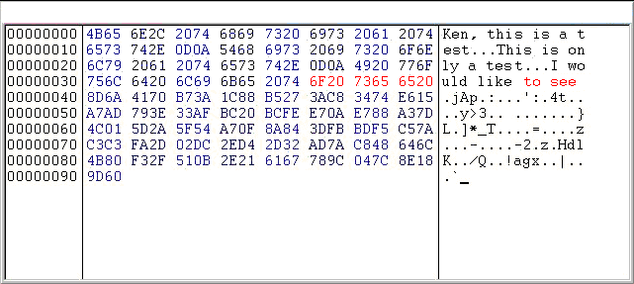
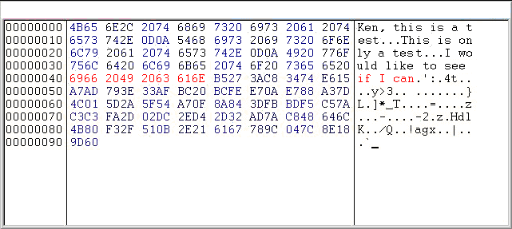
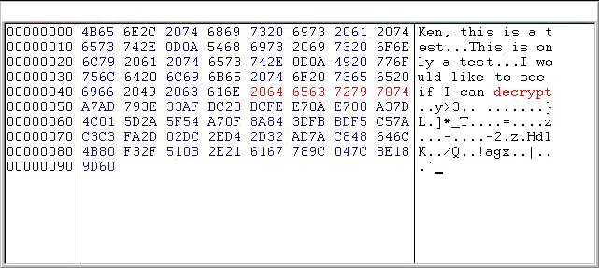
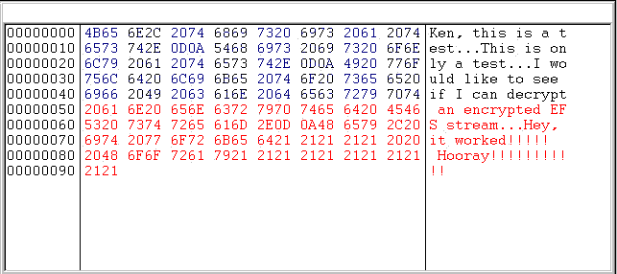
EFS – The Solution (Decrypt)
8 byte blocks at a time

Slide 14
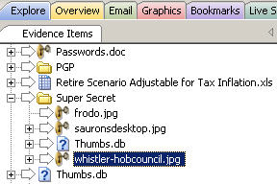
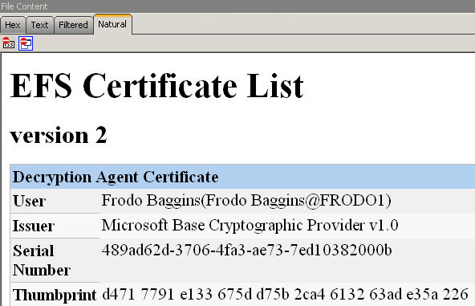

EFS – The Solution (FTK)

Slide 15
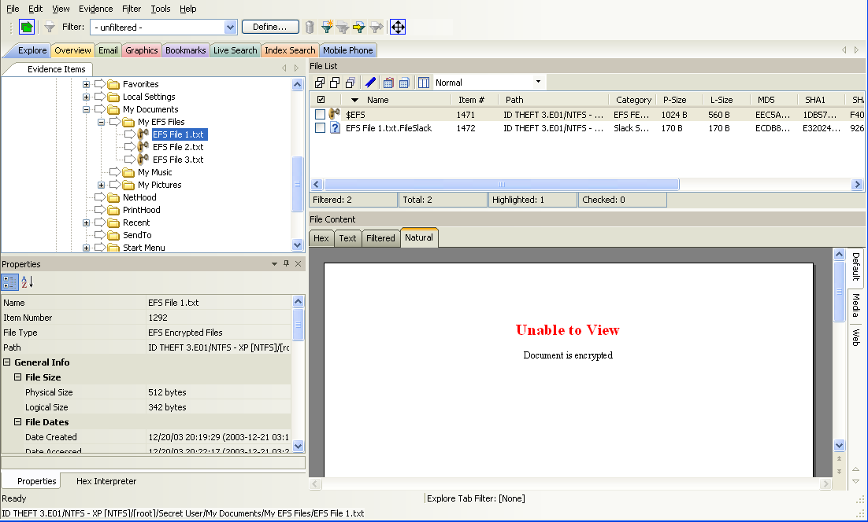
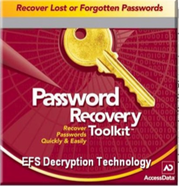
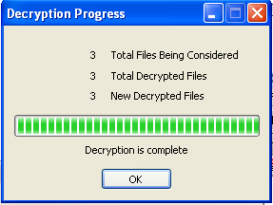
EFS – The Solution (PRTK)

Slide 16

EFS – XP SP 1
Login Password
SHA
MD4 + SysKey
Salt + UserID + MD4 + RC4 + 3Des
SAM File
User’s RSA Private Key

Slide 17
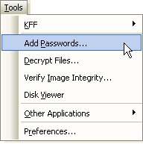

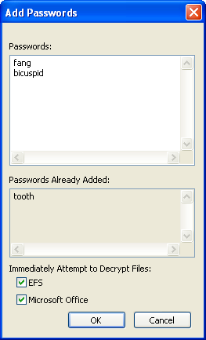
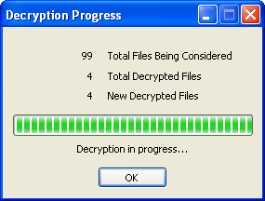
EFS – XP SP1 Attack
For XP SP1 machines, the process is different
So …

Slide 18
EFS – Notes of Interest
Recovery Agents
Required for Windows 2000
Default is Administrator of local computer or domain
Optional for Windows XP Pro
    No default recovery agent
    (Both support multiple recovery agents)
Cannot Encrypt
    System files
    NTFS compressed files
    Files in %Systemroot% and its subdirectories

Slide 19
Module Review
EFS – The Process
  The “FEK”
  Public and Private Keys
  Encrypt and Recovery Agents
EFS – The Problem
  Current – Lost Passwords, Access to files, Who Encrypted it?
EFS – The Solution
  Current – Vulnerability and Advanced Attack (FTK/PRTK)
    Obtaining the DD Private Key
    Obtaining the DR Private Key

Slide 20



